Slide 1






Samsung Electronics
Global Operations Division
Samsung Supply Chain
2026
Credit by: Sagar Sharma
Operational Intelligence
Revolutionizing Logistics through Data-Driven Insights
February 2026
Strategic Review
CONFIDENTIAL
Questions?
INTERNAL USE ONLY
supply.chain@samsung.com

Slide 2


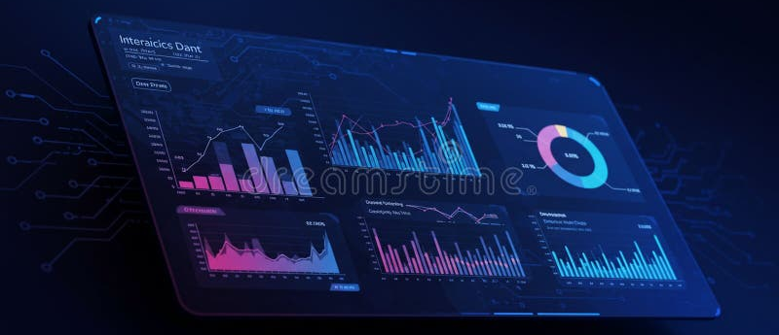
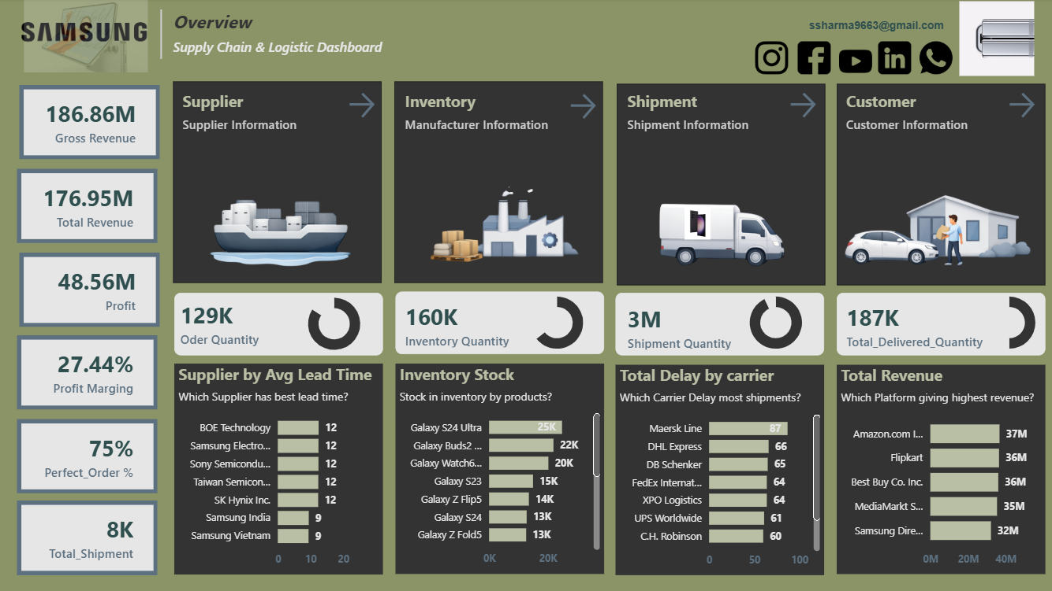


ssharma9663@gmail.com
Executive Overview
The Global Snapshot
Real-time operational metrics across the entire supply chain ecosystem
Total Revenue
Main Dashboard Overview
Live operational intelligence feed
LIVE
$186.86M
+12.4% YoY
Profit Margin
27.44%
Dashboard Screenshot Placeholder
+3.2% vs Target
Real-time KPI visualization
Perfect Order Rate
75%
Baseline Metric

Slide 3

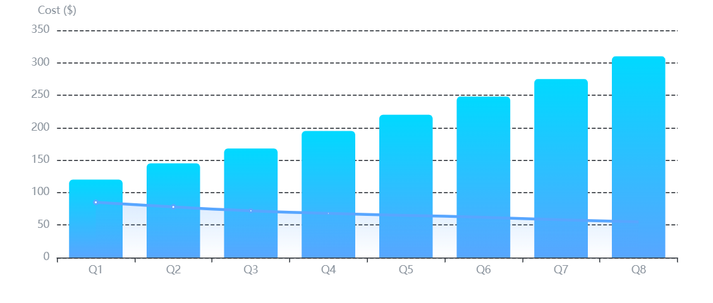
ssharma9663@gmail.com
Supplier Analytics
Strategic Sourcing
Supplier Efficiency & Unit Cost Optimization
Average Lead Time
Quantity vs. Cost Correlation
11.49 Days
Strategic procurement analysis
Unit Cost
Volume
Industry benchmark: 14 days
Key Suppliers
OLED Panels
32%
Semiconductors
28%
Batteries
18%
Memory Chips
22%

Slide 4
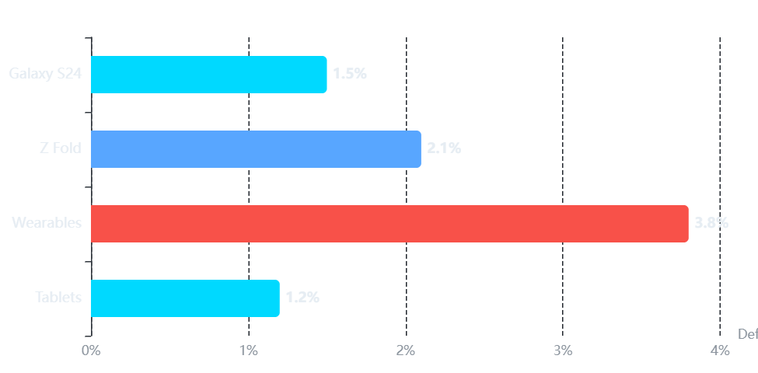
ssharma9663@gmail.com
Stock Management
Inventory & Resilience
Galaxy S24 & Z Fold Series Stock Management
Safety Stock Level
Defect Rate Analysis
89K Units
Quality control metrics by product line
Target: <2%
Zero Production Downtime
Maintained for 18 consecutive months
Product Portfolio
Galaxy S24 Series
45%
Flagship smartphones
Z Fold Series
28%
Foldable devices
Wearables
18%
Smart watches & buds
Tablets
9%
Galaxy Tab series

Slide 5
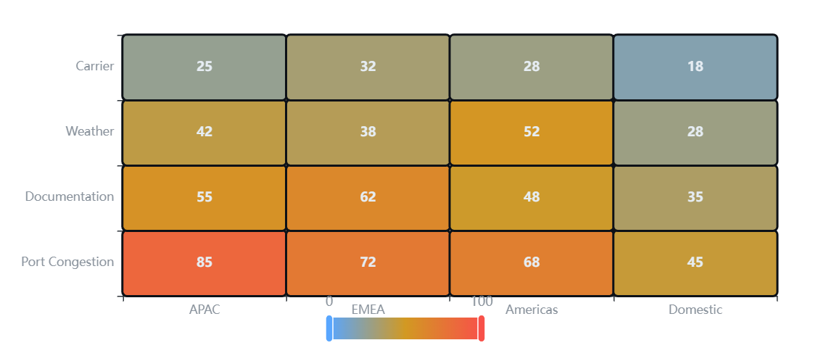
ssharma9663@gmail.com
Critical Issue
The Logistics Bottleneck
Why are we delayed? Root cause analysis of shipment disruptions
Delayed Shipments
Delay Distribution Heatmap
573
Geographic impact analysis
Critical
Moderate
Low
+23% vs last quarter
Primary Delay Causes
Port Congestion
42%
Documentation
28%
Weather Events
18%
Carrier Issues
12%

Slide 6
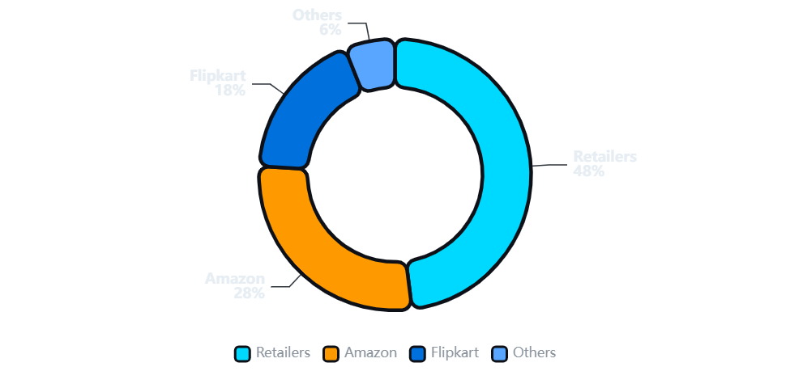
ssharma9663@gmail.com
Sales Channels
Revenue Engines
Amazon vs Flipkart vs Retailers - Channel Performance Analysis
Channel Breakdown
Channel Distribution
Revenue contribution by sales channel
Retailers
48%
Amazon
28%
Flipkart
18%
Others
6%
Key Insight
Online channels growing at 34% YoY, closing the gap with traditional retail

Slide 7
ssharma9663@gmail.com
Critical Analysis
Pain Points & Gaps
Identified vulnerabilities requiring immediate strategic intervention
CRITICAL
15% Impact
HIGH PRIORITY
3.8% Defect Rate
Documentation Issues
Wearables Quality Gap
Manual Processing Delays
Galaxy Watch Series
Paper-based customs documentation causing 15% of all shipment delays
Display connectivity issues and battery performance below spec
Average Delay: 3.2 Days
Galaxy Buds
Per shipment impact on delivery timelines and customer satisfaction
Audio quality inconsistencies and charging case defects
Cost Impact: $2.4M/Quarter
Return Rate: 8.5%
Storage fees, expedited shipping, and penalty costs
Above industry average of 4.2%, impacting brand reputation
Immediate Action Required
Both issues directly impact customer satisfaction and bottom-line performance. Recommend prioritization in Q1 strategic roadmap.

Slide 8
ssharma9663@gmail.com
Action Plan
Strategic Recommendations
Part 1: Immediate Interventions for Critical Issues
AI-POWERED
Q1 Implementation
RISK MITIGATION
Q2 Rollout
AI-Automated Documentation
Supplier Diversification
Objective
Objective
Eliminate 15% documentation-related delays through intelligent automation
Reduce dependency on single-source OLED panel suppliers
Implementation
Implementation
OCR-based document scanning and validation
Onboard 2 additional OLED suppliers (China, Vietnam)
ML-powered error detection and correction
Establish 70-30 split between primary and secondary
Integration with customs APIs for real-time clearance
Implement dynamic supplier switching based on lead times
Expected Impact
Expected Impact
Reduce delays by 85% • Save $2.4M/quarter • Improve CSAT by 12%
Reduce supply risk by 60% • Improve negotiation leverage • Ensure continuity

Slide 9
ssharma9663@gmail.com
Action Plan
Strategic Recommendations
Part 2: Revenue Optimization & Logistics Excellence
REVENUE
Real-time Deployment
LOGISTICS
Immediate Action
Dynamic Pricing Engine
Smart Cargo Re-routing
Objective
Objective
Maximize revenue during Flipkart/Amazon sales events through data-driven pricing
Bypass congested ports for high-value cargo to ensure on-time delivery
Implementation
Implementation
AI model analyzing Discount vs Quantity correlation
Real-time port congestion monitoring system
Real-time competitor price monitoring
Alternative route recommendation engine
Automated price adjustments during peak sales
Priority handling for Galaxy S24 & Z Fold shipments
Expected Impact
Expected Impact
+18% revenue during sales • +5% margin improvement • Reduced stockouts
-40% port delays • +15% on-time delivery • Improved customer satisfaction

Slide 10

Transformation Journey
ssharma9663@gmail.com
The Road Ahead
Moving from Reactive to Predictive Supply Chain
AI-Driven
Connected
Agile
Intelligent automation across all supply chain touchpoints
End-to-end visibility and real-time decision making
Rapid adaptation to market dynamics and disruptions
"Data is the new oil, and Samsung is the refinery."
Transforming raw data into strategic advantage, powering the future of global operations.
Questions?
Samsung Electronics
supply.chain@samsung.com
Global Operations Division

Slide 11
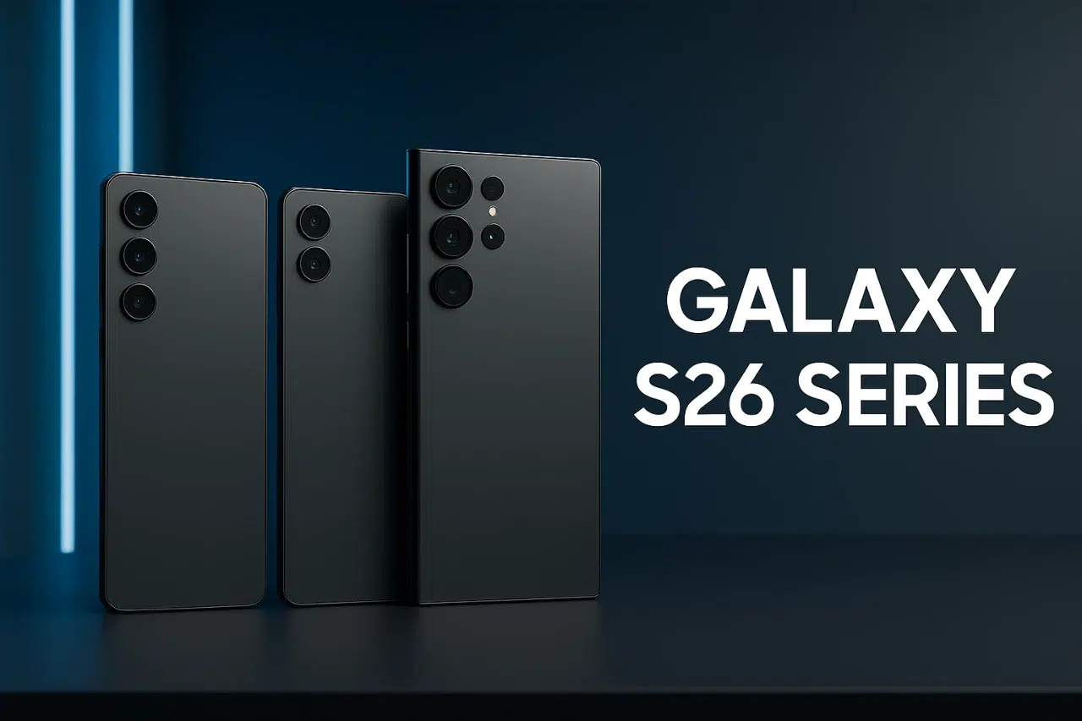


Credit by : SAGAR SHARMA
Let’s Connect
Thank You
Questions?
Samsung Electronics
ssharma9663@gmail.com
Global Operations Division

